Slide 1
Laboratory Earthquake Analysis
Daniel Davieau, Olga Tanyuk

Slide 2
Regular Earthquakes
Catastrophic Stick–Slip Failure Events
Stress builds between tectonic plates over time
Stress eventually overcomes friction
Slip occurs releasing high-frequency seismic energy

Slide 3
The Classical Forecasting Method
Based on the recurrence interval of earthquakes that repeat periodically
Margin of error can span decades
“Similar earthquakes occurring between 1857 and 1966 suggested a recurrence interval of 21.9±3.1 years, and thus, an earthquake was expected between 1988 and 1993, but ultimately took place in 2004”

Slide 4
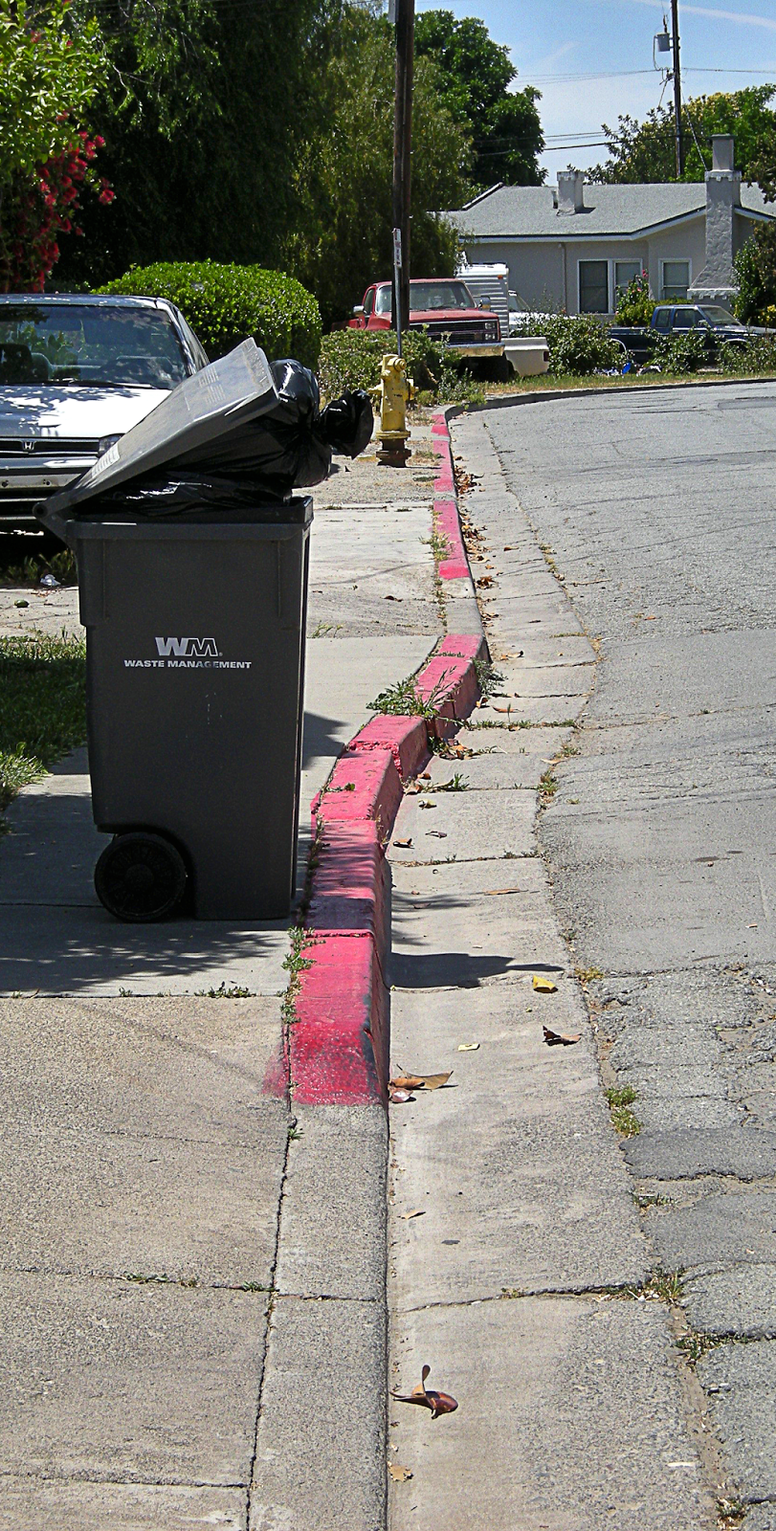
Slow Slip Earthquakes
Slow Slip Earthquakes:
Occur very slowly
Undetectable without Instrumentation
Do not reach rates sufficient to radiate high-frequency seismic energy
Image from http://www.rocdoctravel.com

Slide 5
Slow Slip Earthquakes
May play a role in stress transfer and triggering of regular earthquakes
Behaviors arise near the threshold between stable and unstable failure (before a “Regular” Earthquake)

Slide 6
This Has Already Been Studied
“Can the failure time of an upcoming laboratory earthquake be predicted using characteristics of only the continuously recorded acoustic signal?”
“We show that by listening to the acoustic signal emitted by a laboratory fault, machine learning can predict the time remaining before it fails with great accuracy”
- Rouet-Leduc Bertrand, Hulbert Claudia, Lubbers Nicholas, Barros Kipton, Humphreys Colin J., JohnsonPaul A. (2017, July 15). Machine Learning Predicts Laboratory Earthquakes. Retrieved from https://doi.org/10.1002/2017GL074677

Slide 7
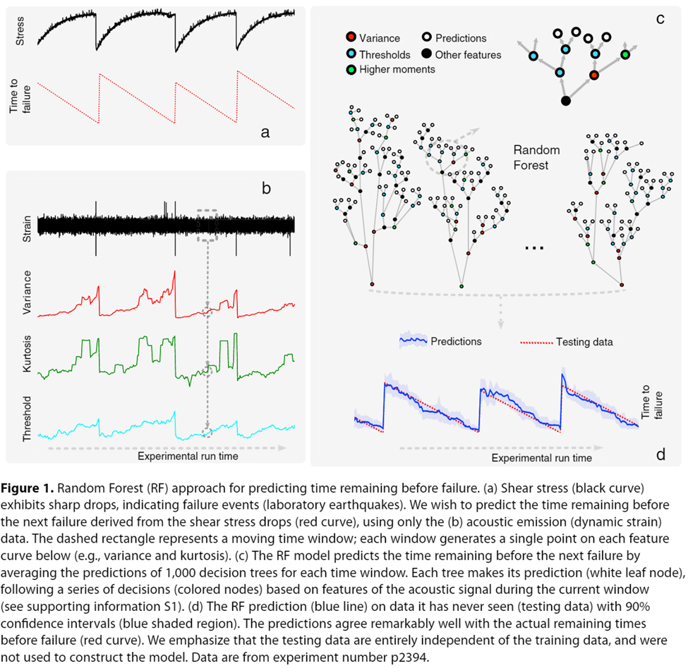
Source: Rouet-Leduc Bertrand, Hulbert Claudia, Lubbers Nicholas, Barros Kipton, Humphreys Colin J., JohnsonPaul A. (2017, July 15). Machine Learning Predicts Laboratory Earthquakes. Retrieved from https://doi.org/10.1002/2017GL074677

Slide 8
There Have Been Advances in Technology
Improvement in the Instruments for Measuring Signals
Improvement in Computing Power

Slide 9
Los Alamos National Laboratory -
“we selected an experiment that exhibits a very aperiodic and more realistic behavior compared to the data we studied in our early work”.
“The data from this classic earthquake machine had never been studied using ML until our early efforts 3 years ago, and much remains to be explored and discovered.”

Slide 10
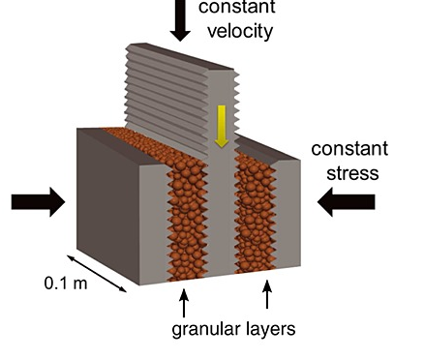
Data Recroded by LANL
Lab simulation data; not real earthquake data

Slide 11
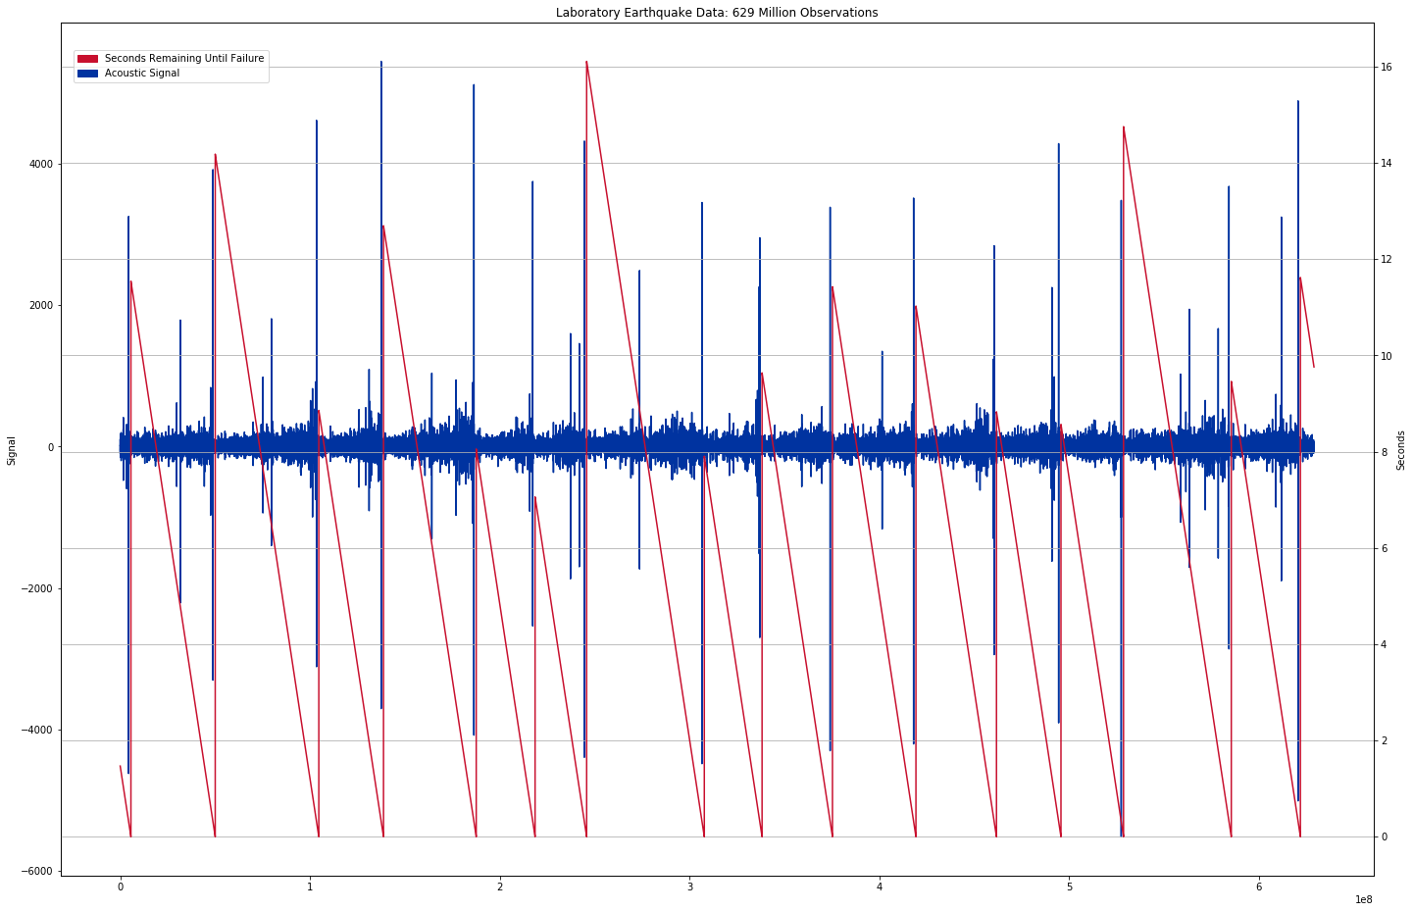
Data Recorded by LANL

Slide 12
Problem Statement
Given a higher volume of more aperiodic earthquake failures (than LANL’s study); can we predict laboratory earthquakes?

Slide 13
Methodology
Random Forest

Slide 14
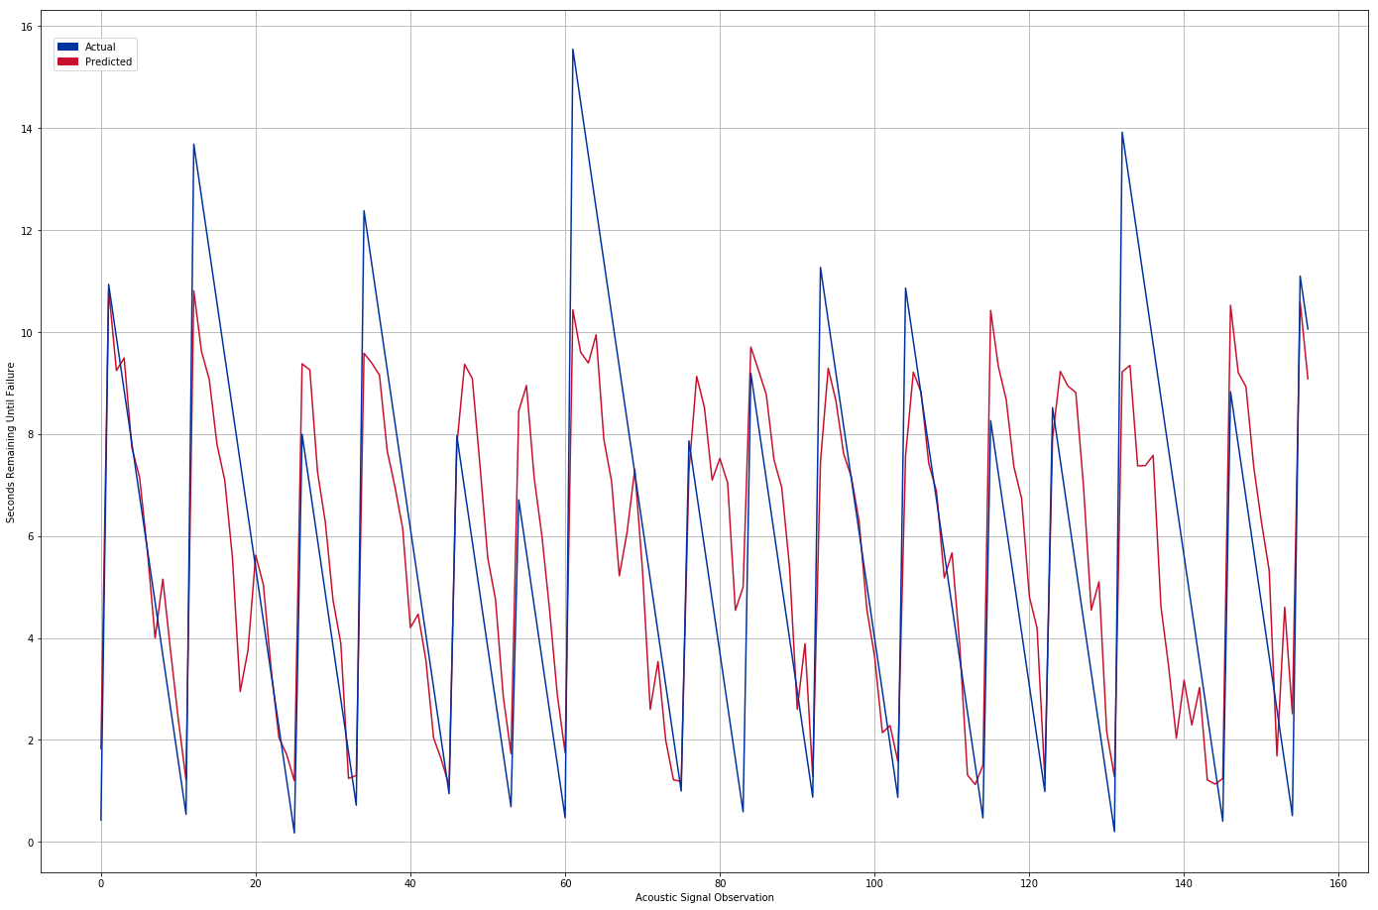
Results

Slide 15
Results
TBD Coefficient of Determination
TBD Mean Absolute Error

Slide 16
From Lab to Real World
“If this challenge is solved and the physics are ultimately shown to scale from the laboratory to the field, researchers will have the potential to improve earthquake hazard assessments that could save lives and billions of dollars in infrastructure.”
- Los Alamos National Laboratory, Geophysics Group

Slide 17
From Lab to Real World
The experiment closely mimics Earth faulting, so the same approach may work in predicting timing, but not size, of an earthquake. This approach could be applied to predict avalanches, landslides, failure of machine parts, and more
- Los Alamos National Laboratory, Geophysics Group

Slide 18
Ethical Considerations
If people believe us and we are wrong; bad things can happen
If people believe us and we are right; good and bad things can happen
Responsibility to inform the public about their results may conﬂict with their responsibility not to cause social disturbance

Slide 19
References
Bertrand Rouet-Leduc, Claudia Hulbert, Machine learning predicts laboratory earthquakes
Kaggle, R.: Lanl earthquake prediction
Ikari Matt J, Marone Chris, : Slip weakening as a mechanism for slow earthquakes
Baptiste Rousset, Roland Burgmann, M.C.: Slow slip events in the roots of the san andreas fault
USGS: What is an earthquake and what causes them to happen? (March 2019)
Rouet-Leduc, B.: Los Alamos machine learning discovers patterns that reveal earthquake fault behavior
Ayhan Sol, Halil Turan: The ethics of earthquake prediction. Volume 10, ​Issue 4​, pp 655–666 (December 2004)

